Slide 1
DANI KRUHA 2012.
OŠ VLADIMIRA NAZORA, PRIBISLAVEC

Slide 2
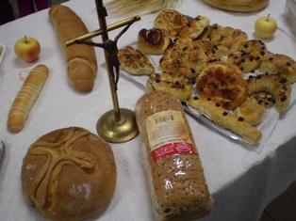
DANI-KRUHA-2012.

Slide 3
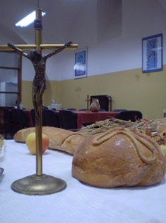
DANI-KRUHA-2012.

Slide 4
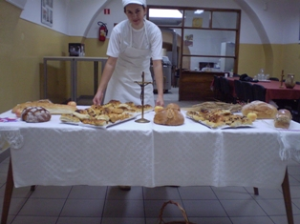
DANI-KRUHA-2012.

Slide 5
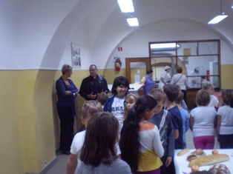
DANI-KRUHA-2012.

Slide 6
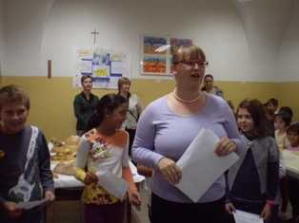
DANI-KRUHA-2012.

Slide 7
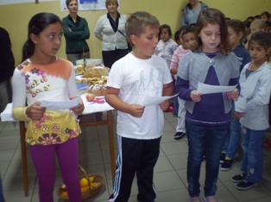
DANI-KRUHA-2012.

Slide 8
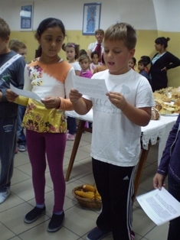
DANI-KRUHA-2012.

Slide 9
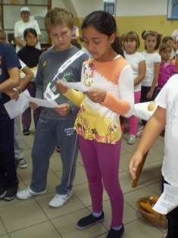
DANI-KRUHA-2012.

Slide 10
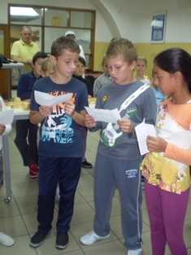
DANI-KRUHA-2012.

Slide 11
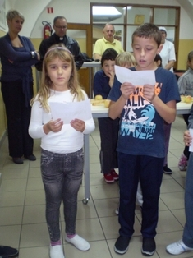
DANI-KRUHA-2012.

Slide 12
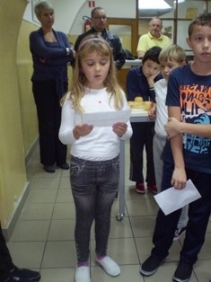
DANI-KRUHA-2012.

Slide 13
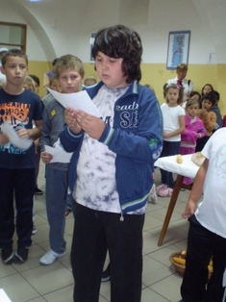
DANI-KRUHA-2012.

Slide 14
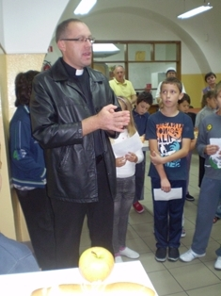
DANI-KRUHA-2012.

Slide 15
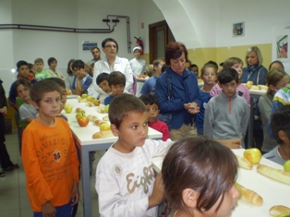
DANI-KRUHA-2012.

Slide 16
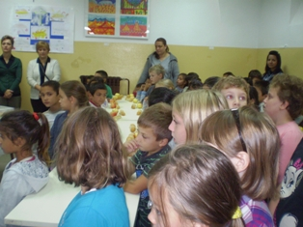
DANI-KRUHA-2012.

Slide 17
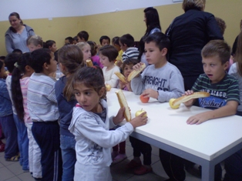
DANI-KRUHA-2012.

Slide 18
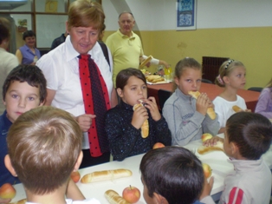
DANI-KRUHA-2012.

Slide 19
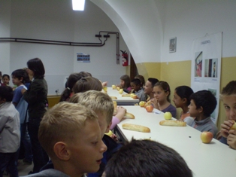
DANI-KRUHA-2012.

Slide 20
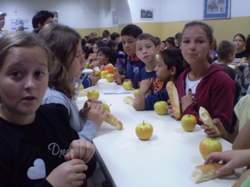
DANI-KRUHA-2012.

Slide 21
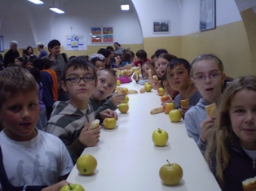
DANI-KRUHA-2012.

Slide 22
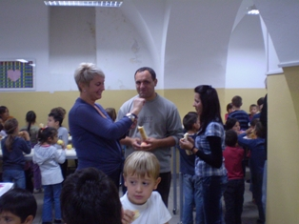
DANI-KRUHA-2012.

Slide 23
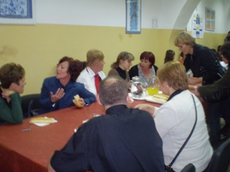
DANI-KRUHA-2012.

Slide 24
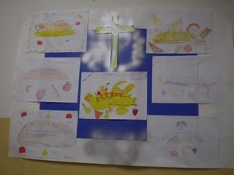
DANI-KRUHA-2012.

Slide 25
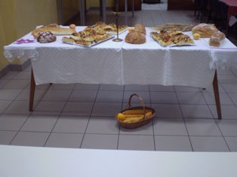
DANI-KRUHA-2012.

Slide 26
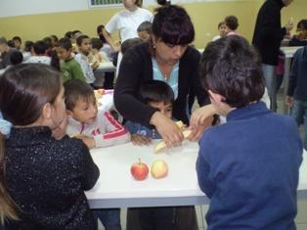
DANI-KRUHA-2012.

Slide 27
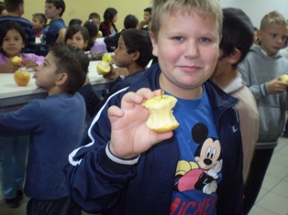
DANI-KRUHA-2012.

Slide 28
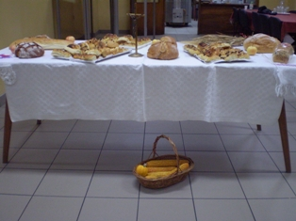
DANI-KRUHA-2012.

