Slide 1
National parks

Slide 2
Croatia has eight national parks.
Each of them is a wonderful in its own way.
Their unspoiled nature takes almost 8 % of Croatia.

Slide 3
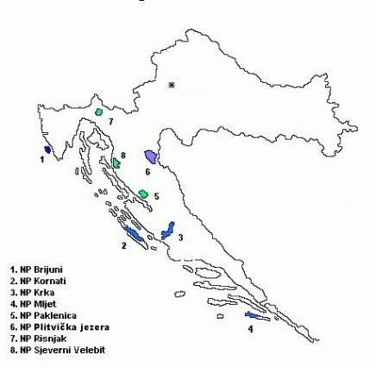
National parks: BRIJUNI
KORNATI
KRKA
MLJET
PAKLENICA
PLITVIčKA JEZERA
RISNJAK
SJEVERNI VELEBIT

Slide 4
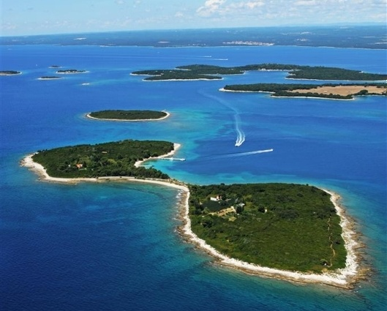
Brijuni
The Brijuni or the Brijuni Islands are a group of fourteen small islands in the Croatian part of the northern Adriatic Sea, separated from the west coast of the Istrian peninsula by the narrow Fažana Strait. Famous for their beauty, the islands are a holiday resort and a Croatian National Park.

Slide 5
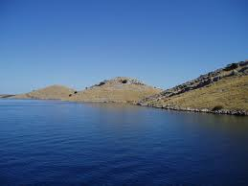
Kornati
National park Kornati was declared in 1980 and then was placed under protection. The total area of the park is about 220 square kilometers and consists of 89 islands, islets and rocks. The park area is only about 1/4 of the land, while the rest of the marine ecosystem.

Slide 6
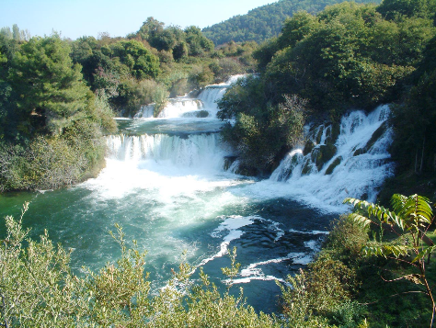
Krka
Krka National Park is one of the Croatian national parks, named after the river Krka that it encloses. It is located along the middle-lower course of the Krka River. It is the seventh national park in Croatia and was proclaimed a national park in 1985.

Slide 7
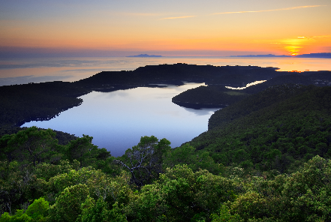
Mljet
Mljet is the most southerly and easterly of the larger Adriatic islands of the Dalmatia region of Croatia. The National Park includes the western part of the island, Veliko jezero, Malo jezero, Soline Bay and a sea belt 500 m wide from the most prominent cape of Mljet.

Slide 8
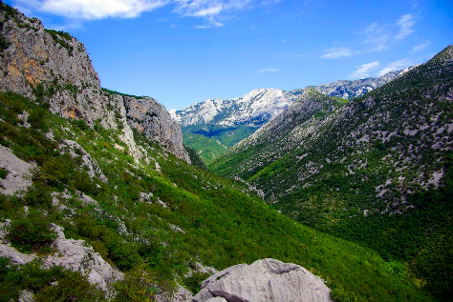
Paklenica
The Paklenica karst river canyon is a national park in Croatia. It is located in Starigrad, northern Dalmatia, at the southern slopes of Velebit mountain, not far from Zadar. It has two canyons: Mala (Small) and Velika (Big) Paklenica. Today there is no water flowing throughout Mala Paklenica.

Slide 9
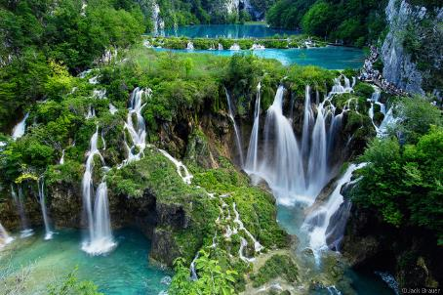
Plitvička jezera
Plitvice Lakes National Park is one of the oldest national parks in Southeast Europe and the largest national park in Croatia. In 1979, Plitvice Lakes National Park was added to the UNESCO World Heritage register.

Slide 10
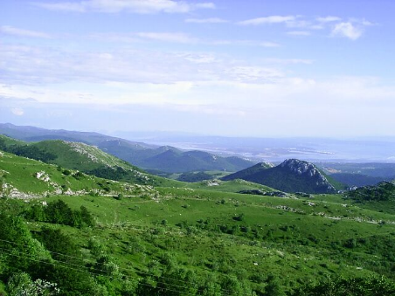
Risnjak
Risnjak National Park is a national park in Croatia. It is located in Gorski kotar, the most mountainous and heavily forested region of the country, about 15 km inland from the Adriatic Sea.

Slide 11
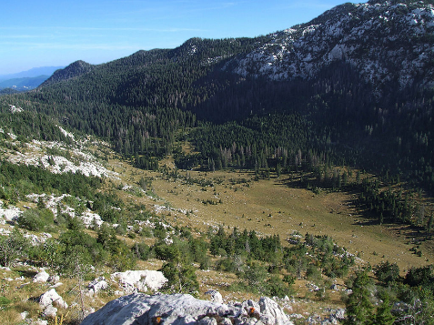
Sjeverni Velebit
The Northern Velebit National Park is a national park in Croatia that covers 109 km2 of the northern section of the Velebit mountain, the largest mountain in Croatia.

Slide 12
Created for the eTwinning project Where is my green environment?
European Day of Parks
OŠ Vladimira Nazora Pribislavec, Croatia
May 2016
Made by: Leona Vadlja & Anja Šmitran, 6a
Teacher: Iva Naranđa

